Slide 1

NS-Rentals
Transforming Halifax Rental Market For Southwest Properties
Masters of Computing & Data Analytics
Saint Marys University
Halifax, Nova Scotia
BlackHoles-X

Slide 2




MEET THE TEAM
MCDA - Student
MCDA - Student
MCDA - Student
MCDA - Student
Tejasvi Bhutiyal
Raoof Naushad
Rakshit Gupta
Vrushali Prajapati
BlackHoles-X

Slide 3
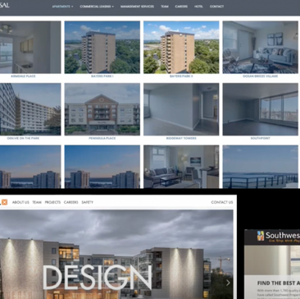
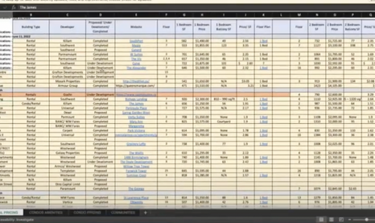
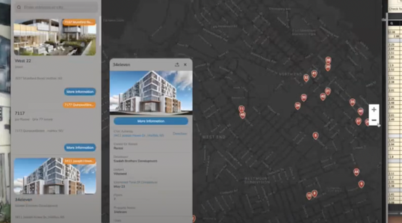
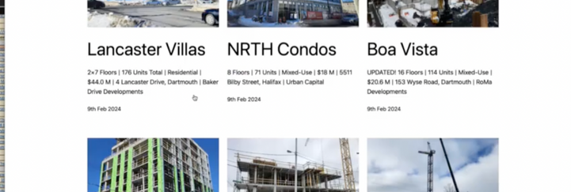
PROBLEM STATEMENT
Overview of Current Method
Challenges with the Current Method
Proposed Enhancements
Manual compilation of competitor analysis data into Google Sheets.
Data from Google Sheets is synced with an online platform to create visual and database dashboards.
Labor-intensive process requiring substantial manual input.
Infrequent updates lead to the use of stale data.
Time-consuming procedures reduce operational efficiency.
Stale data negatively impacts pricing strategies and market competitiveness.
Automate the data collection process to eliminate manual spreadsheet creation.
Implement advanced data scraping and analytics tools to ensure real-time data updates.
Enhance dashboard system for more dynamic and accurate data visualization.
BlackHoles-X

Slide 4
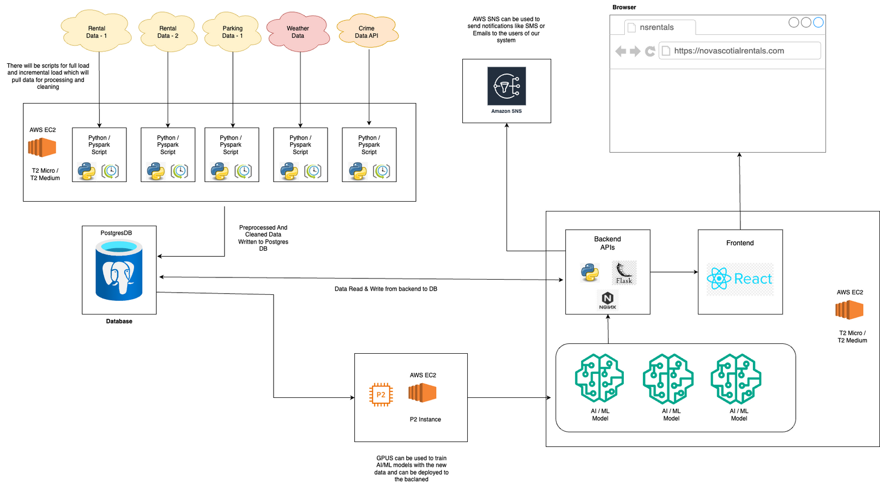
ARCHITECTURE
BlackHoles-X

Slide 5
OUR UNIQUE SOLUTION
Semi-Automated Data Collection
Rental - Prediction & Property Clustering
Automated ML Training
Deep Insights Dashboard
LLM-Generated Insights
Alert Systems
BlackHoles-X

Slide 6
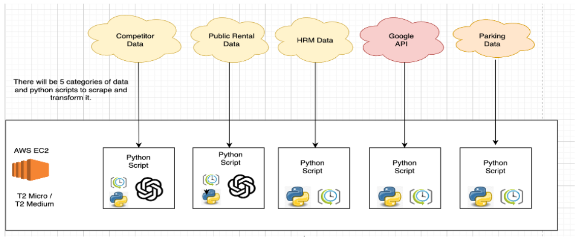
AUTOMATED DATA COLLECTION
Our semi-automated data collection module streamlines the extraction of real estate listings and competitor information, despite variations in website structures. We incorporate human oversight to ensure the accuracy and quality of the data collected. Verified data is immediately integrated into our database, supporting our dashboard and listings with the most current market analysis. Additionally, we employ Large Language Models from OpenAI, using a 'Chain of Thoughts' technique to adapt our scraping capabilities to diverse web architectures, enhancing the precision of our data extraction.
DataExtraction / RealTimeAnalytics / OpenAIIntegration
BlackHoles-X

Slide 7
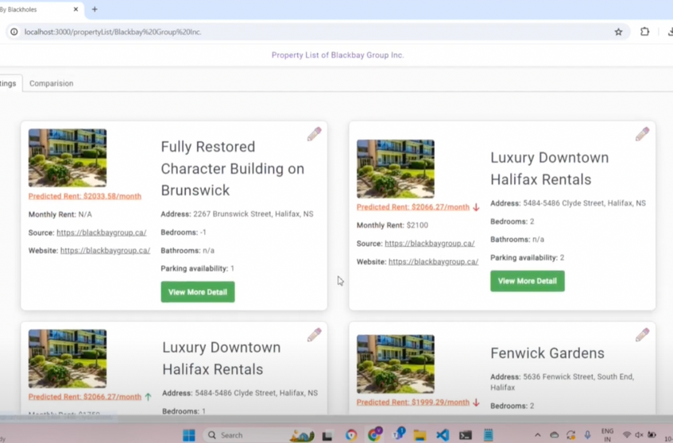
RENTAL - PREDICTION & PROPERTY CLUSTERING
To master the complexities of rental pricing, our advanced machine learning models utilize a vast dataset from public and competitor sources to forecast rental rates accurately. These predictions help analysts determine if listed rents align with or deviate from market trends, providing a vital competitive advantage. Furthermore, our property clustering module categorizes similar properties into groups, giving analysts a clear overview of the competitive landscape and facilitating more informed decision-making regarding rental pricing strategies.
RentalForecasting / PropertyClustering / CompetitiveEdge
BlackHoles-X

Slide 8
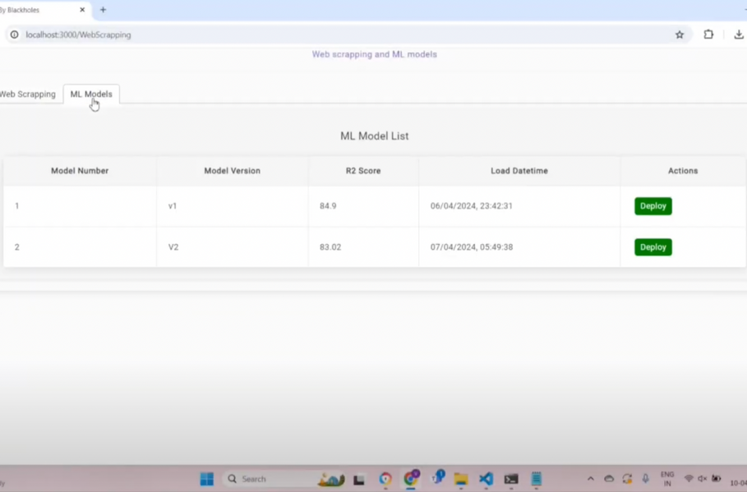
AUTOMATED ML TRAINING
NS-Rentals includes an automated retraining pipeline that continuously updates our machine learning models with new data to maintain sharp and current insights. This robust system enhances model accuracy and permits real-time deployment of the most effective models. Once reviewed and scored, these models are immediately implemented through our user interface, ensuring that our tools are always equipped with the latest technological advancements to drive decision-making.
MachineLearning / RealTimeInsights / AutomatedRetraining
BlackHoles-X

Slide 9
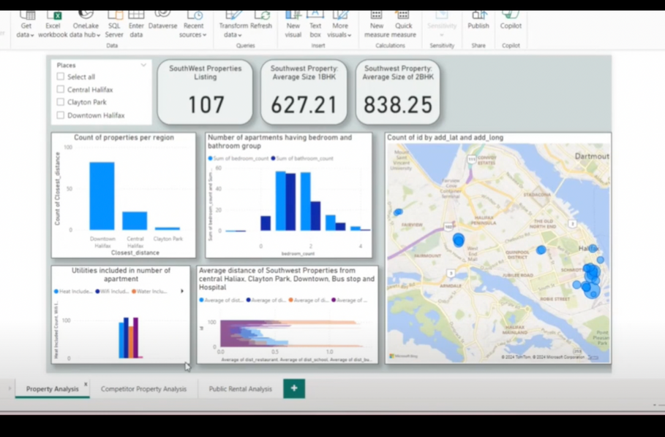
DEEP INSIGHTS DASHBOARD
Our dashboard transcends traditional data presentations by delivering deep insights into the Halifax rental market through advanced analytics. Enhanced by Google API, it offers practical features such as locating nearest parking options with availability and rates, and calculating distances from properties to key areas including Downtown and Southend Halifax, Central Halifax, Clayton Park, Rockingham, and Larry Uteck area, along with essential amenities like bus stops, restaurants, and hospitals. The dashboard includes a map-based system for visualizing properties and parking, facilitating detailed comparisons and tailored recommendations. Integrated with real-time data from our automated scraping tools, our dashboard provides a dynamic and current view of market conditions, making it an indispensable resource.
AdvancedAnalytics / DynamicDashboard / RealTimeData
BlackHoles-X

Slide 10
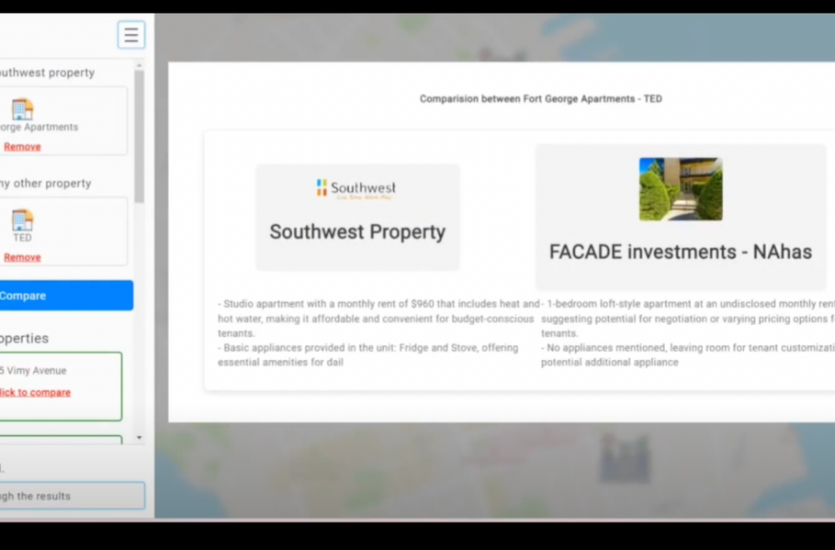
LLM-GENERATED INSIGHTS
NS-Rentals enhances its analytical capabilities by incorporating AI-driven comparisons using Large Language Models from OpenAI. This feature enables the analysis of two listings or property management firms by detailing their strengths and weaknesses, which aids in strategic planning. Our use of sophisticated prompt engineering techniques ensures that these comparisons are not only comprehensive but also tailored to be user-oriented, providing clear and actionable insights that help in making informed decisions.
AIDrivenAnalytics / StrategicPlanning / ComprehensiveInsights
BlackHoles-X

Slide 11
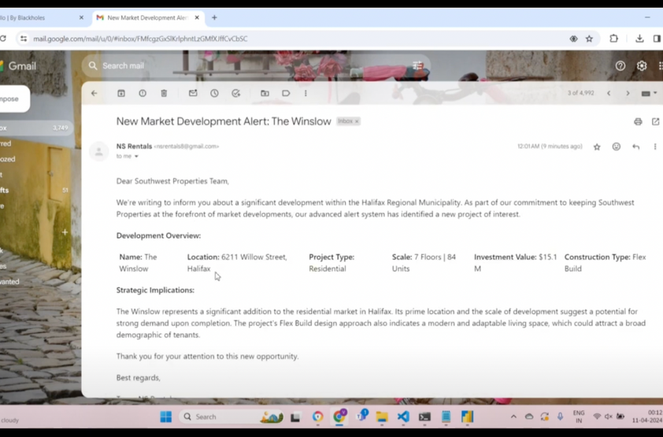
ALERT SYSTEMS
NS-Rentals equips Southwest Properties with an advanced alert system to stay ahead in the competitive Halifax rental market. Our system meticulously monitors developments within the Halifax Regional Municipality by scraping HRM Blog channels. This ensures that all new market advancements are quickly communicated to our analysts through email alerts. This proactive approach allows Southwest Properties to swiftly respond to new opportunities and regulatory changes, thereby maintaining their competitive edge in a dynamic market environment.
MarketAlerts / ProactiveUpdates / CompetitiveEdge
BlackHoles-X

Slide 12
Thank you!
NS-Rentals: Transforming the Halifax Rental Market
Masters of Computing & Data Analytics
Saint Marys University
Halifax, Nova Scotia
BlackHoles-X

